Slide 1




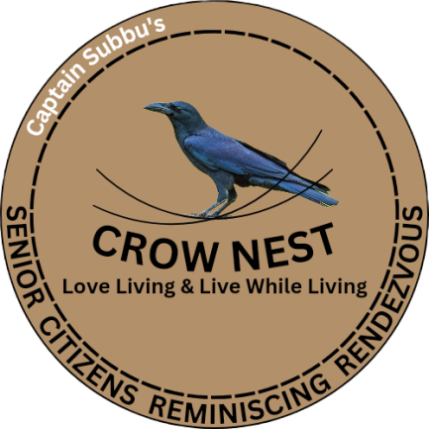
Captain Subbu’s
Outdoorsman Training Academy
Go Out – Grow Smart – Glow Bright
Captain Subbu’s
Captain Subbu’s
Camp Catapult
I Can – I Will – I Do
Captain’s Barrack
Feel the Soldier in You
Captain Subbu’s
Crow Nest
Love Living & Live While Living
Expand the Known & Explore the Unknown to GROW and GLOW
Sail through ‘Outdoorsmanship – Sportsmanship – Friendship – Comradeship – Leadership’ Circle

Slide 2

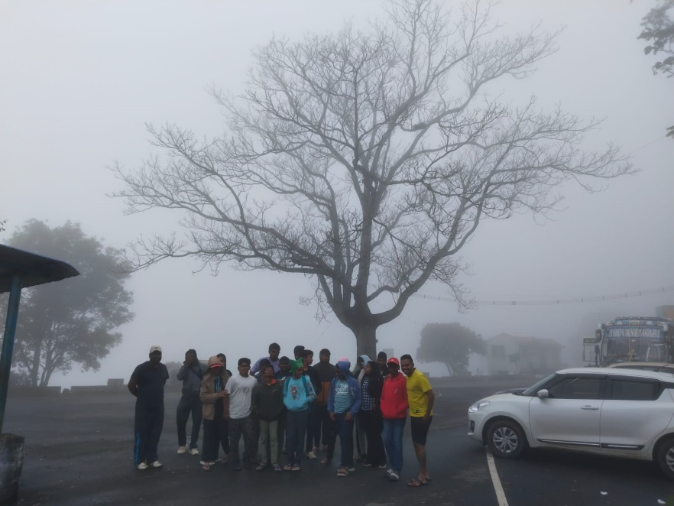
The Flow
Vision
Mission
Objective
Concept
Focus
What We Do? The Services & Programs
Whom We Do? The Participants
Why We Do? The Takeaways
Where We Do? The Campsites, Barracks & Nests
Who Will Do? The Facilitating Team

Slide 3



Vision / Mission / Objective
Vision: Developing an environment for people to make ‘Bonding’ to understand the value of ‘Teamwork & Social Living in Harmony with the Nature’
Mission: Creating an environment for ‘Creating Creativity’ with nature that brings Positive Transformation in the Mind, Brain & the Body in a natural way
Objective: Establishing Integrated Campsites / Barracks / Rendezvous with ideal environment at multiple locations that provide ample opportunities for the visitors to engage into a Transformation through a gambit of Learning, Entertainment, Relaxation and Rejuvenation with nature
Concept – OWNER with MANER
OWNER
O – Outdoorsmanship
W – Wisdom
N – Nature
E – Entertainment / Enjoyment
R – Relaxation / Rejuvenation
MANER
M – Management Training
A – Adventure Activities
N – Nature
E – Entertainment / Enjoyment
R – Relaxation / Rejuvenation
Takeaway
Sail through ‘Outdoorsmanship – Sportsmanship – Friendship – Comradeship – Leadership’ Circle

Slide 4
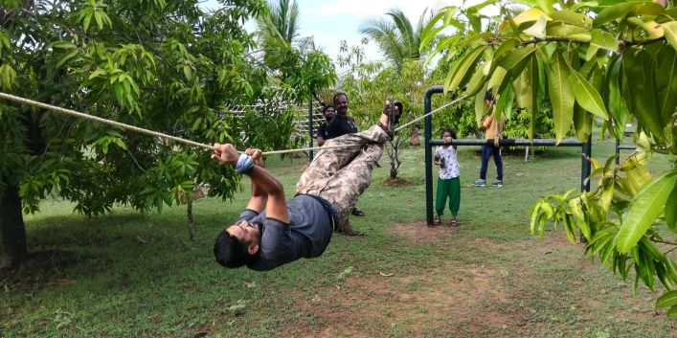
The Focus
Expose People to ‘Expand the Known & Explore the Unknown’ by Transforming the Mind to Believe ‘I Can, I Will & I Do’
I Can – Perceived from the Past (Yesterday)
I Will – Presuming for the Future (Tomorrow)
I Do – Performing in the Present (Today)
This World is for the Survival of the Fittest & You need to be the Finest among the Fittest!

Slide 5
What We Do? – The Services & Programs

Slide 6
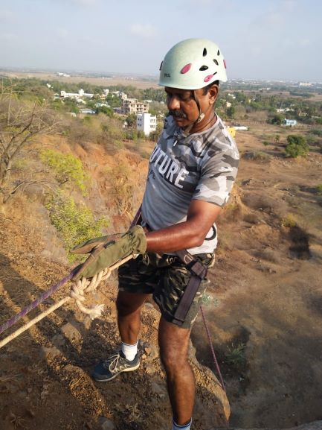
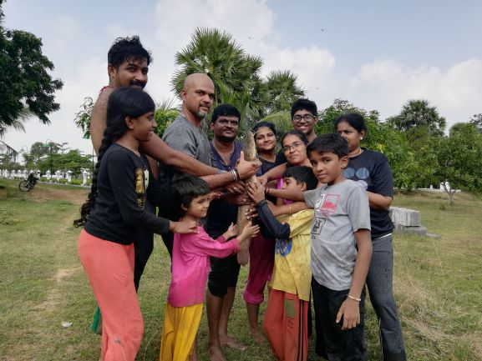
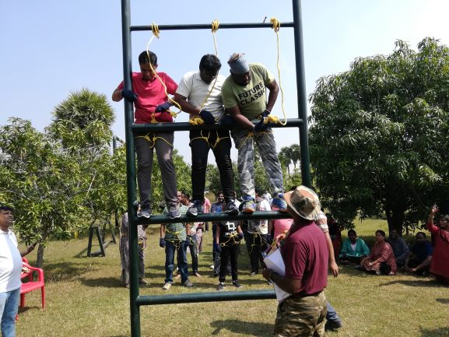
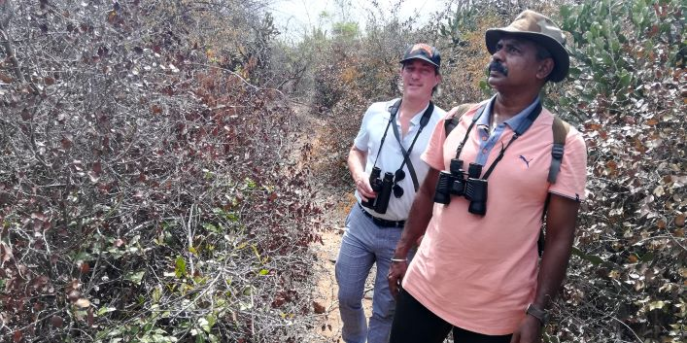
Services – Camp Catapult Facilitates ‘ACTORS'
A – Adventure Activities
C – Camping
T – Transformation through Training (GROW and GLOW)
O – Outdoorsmanship
R – Road Less Travelled (Nature Trails & Treks, Bird Watching, etc.)
S – Sightseeing / Special Trips

Slide 7
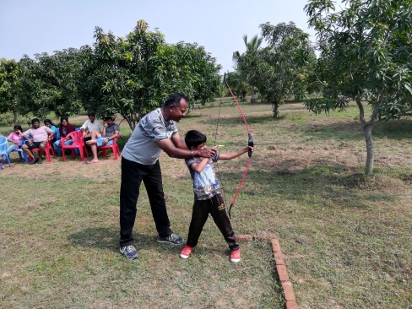
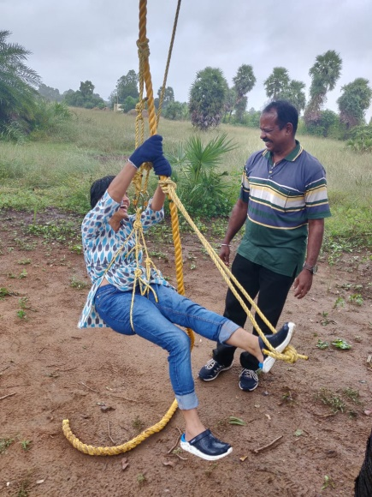
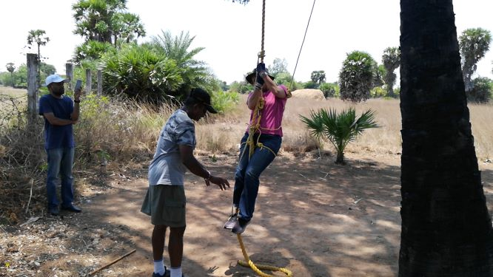
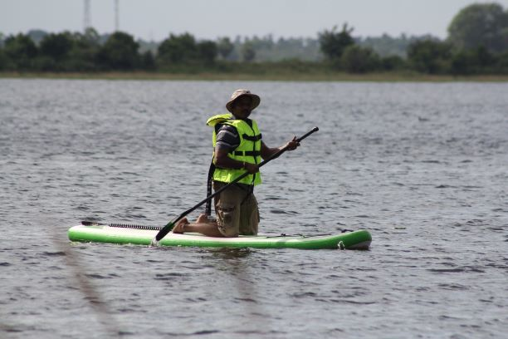
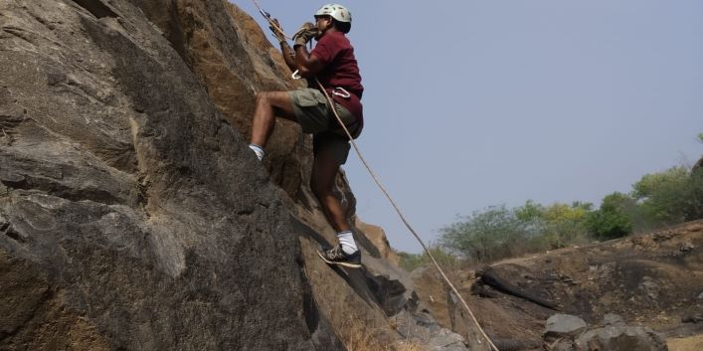
Adventure Activities
1. Archery
2. Catapult Shooting
3. Air Rifle Shooting
4. Obstacle & Rope Course
5. Rock Climbing
5. Jummaring
6. Rappelling
7. Stand Up Paddling (SUP) – Subject to Feasibility

Slide 8
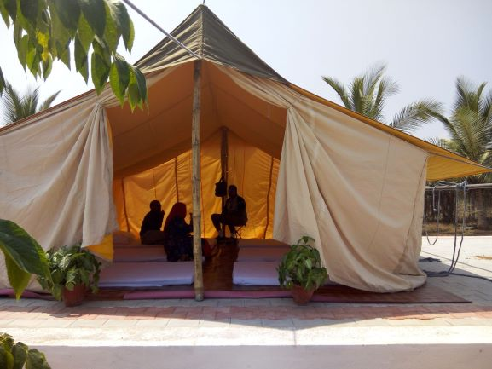
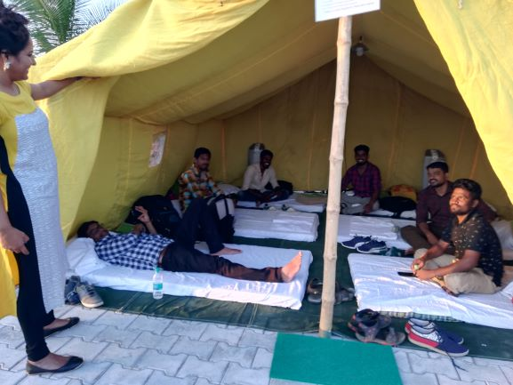
Camping
Overnight Camping
Stay in Tents
Sky-Gazing
Bonfire & Barbeque
Scout & Boot Camp
Vibrant Outdoorsmanship
Corporate & Family Outing with Purpose

Slide 9
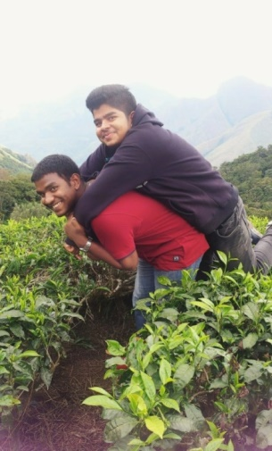
Transformation through Training Programs
GROW and GLOW
1. Out Bound Training (OBT) & Team Bonding Activities (Teamwork Works)
2. Beginner’s Workshops
3. Invigorative Explorations – Expand the Known & Explore the Unknown (2 to 20 Days)
4. Workshop / Coaching / Mentoring
A. Vibrant Outdoorsmanship – Making of a Vibrant Human Being (4+1 Days Workshop)
Invigorate your Outdoor Ambitions through 360° Integrated Comprehensive Guidance on Outdoor Ventures with Practical Explanations for Personal Applications
B. Accomplish your Ambitions – Making of a Warrior Entrepreneur Leader (6 Hours Coaching)
Envision the Vision with an Entrepreneur’s Smartness and Execute the Mission with a Warrior’s Shrewdness & Conquer your World with Confidence imbibing ‘Art of Warrior Entrepreneur Leadership’
C. Achiever Regeneration Camp (ARC) – Invigorating the Inner Energy through Outdoor Ventures (2 to 20 days Mentoring)
Make your ‘Action’ an ‘Attraction’ & ‘Achievement’ a ‘Celebration’ by exploring Outdoorsmanship, Leadership, Sportsmanship, Life & Living Skills through Camping at Exotic Locations in different parts of the country

Slide 10
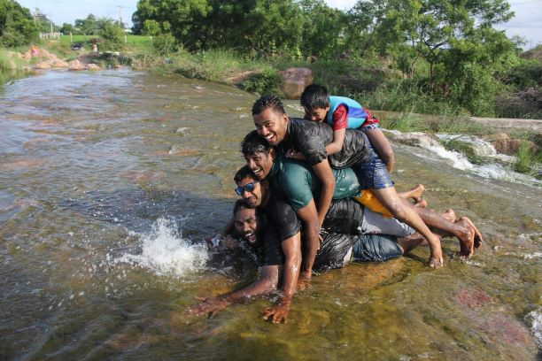
Out Bound Training (OBT) & Team Bonding (Teamwork Works)
1. Team Making
A. It is ensured that teams are equally balanced keeping factors like Gender, Age, Status, etc. in mind
2. Ice-Breaking
A. Initial games with fun & frolic to break the ‘Individualism’ and get into ‘Team Spirit’
B. Individual ‘Breaking’ & Team ‘Bonding’
3. TEM through TEAM
A. Total Effective Management (TEM)
B. Together Everyone Achieves More (TEAM)

Slide 11
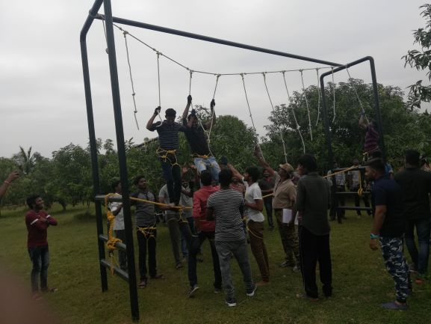
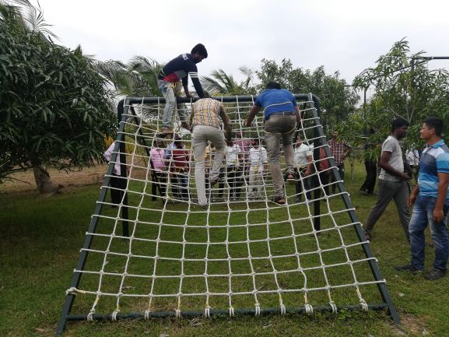
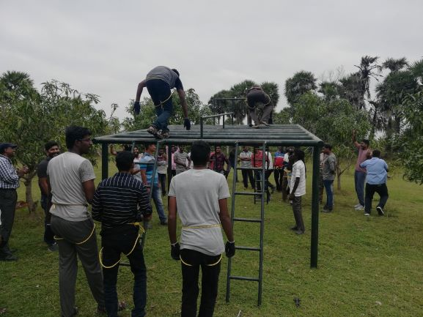
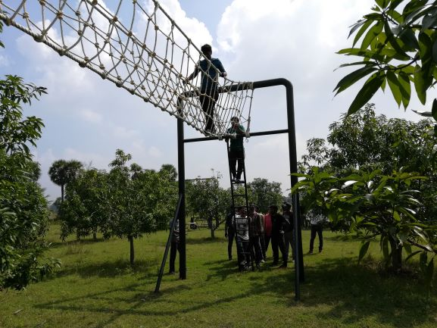
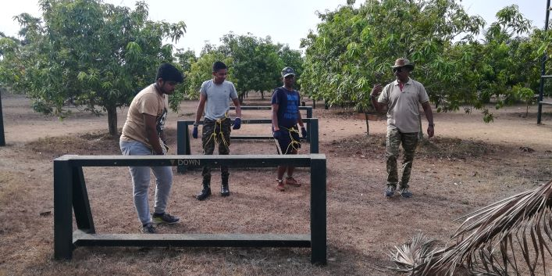
4. KRA² – Key Result Area to guide the Key Research Area
Teamwork Works
Team Building
Team Bonding
Accelerating Group Dynamics
Leadership Traits Exposition
Individual Talents Exposition
Involvement with Ownership
Ability to Plan & Organize as a Group
Ability to take Decisions & Calculated Risks
Ability to Learn the Best Practices from others
Ability to Handle Demanding Situations in a Cool, Composed, Efficient & Effective Manner
Individual’s Effect on Team & Team’s Effect on Individuals
Exposing to Adventure keeping Overall Safety in Mind
Romancing the Nature
Management Factors Effecting or Affecting Life / Work (Influencing Directly or Indirectly)
KRA² (Key Result Area (to know where you are now) & Key Research Area (to plan where you need to go)

Slide 12
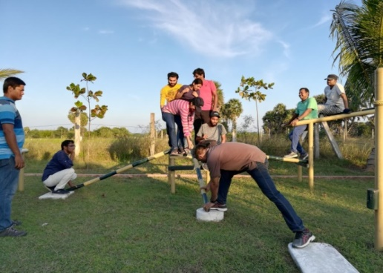
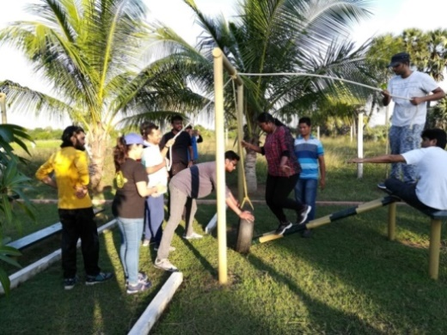
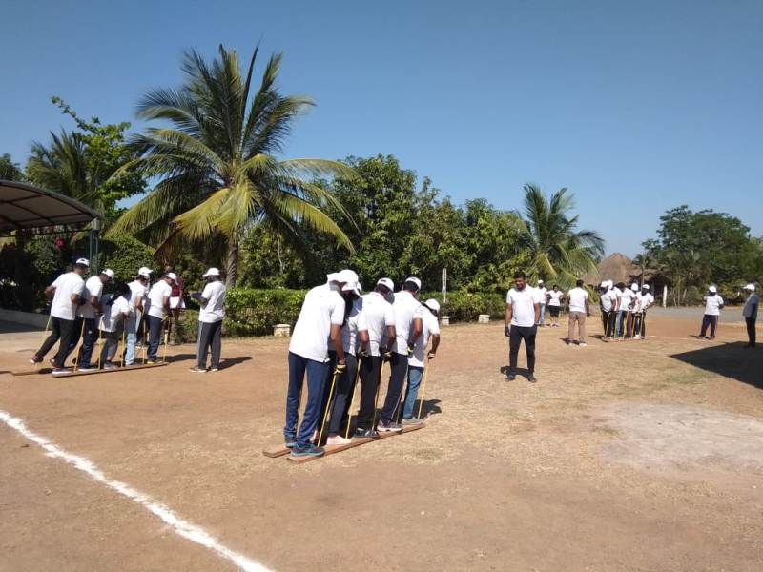
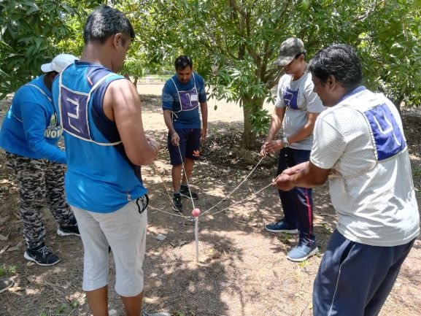
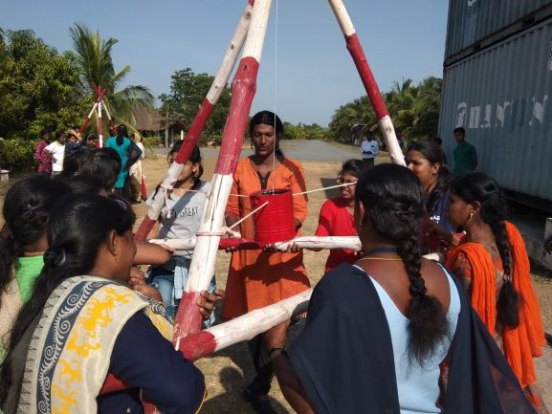
OBT & Team Bonding Activities
1. Obstacle Challenging & Overcoming (OCO)
2. Dynamic Obstacle Challenging & Overcoming (DOCO)
3. Mind, Brain & Body Coordination (MBBC)
4. Improvised Team Bonding Activities (ITBA)

Slide 13
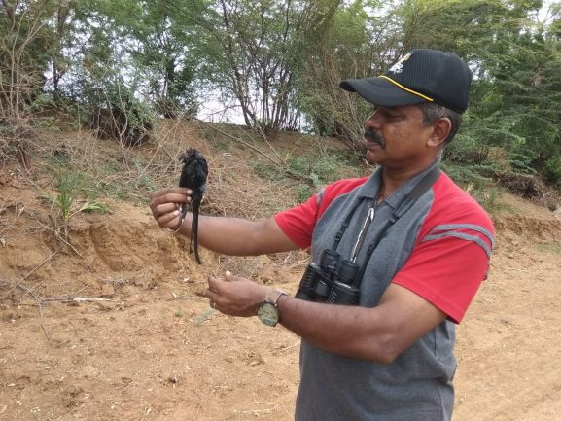
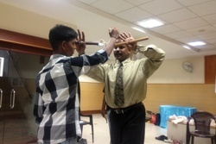
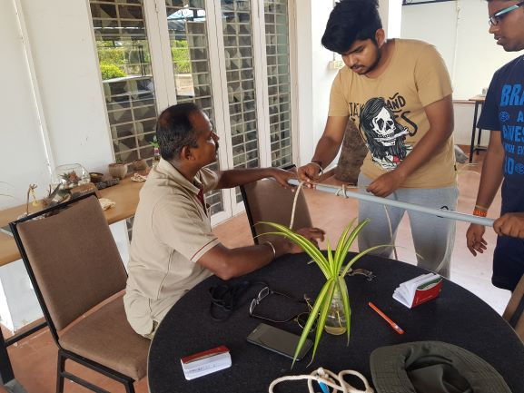
Catapult Beginner’s Workshop
1. Multiple Hobbies
2. Astronomy & Sky-Gazing
3. Orienteering & Navigation
4. Rope Knots, Lashing & Coiling
5. Birds & Birding (Basics)
6. Snake Rescue & Relocation (Preliminary)
7. Solving Rubik’s Cube
8. Juggling with 3 Balls
9. Nunchaku
10. Silambam (The Long Stick Fight)
11. Fifteen Minutes Fitness & Self-Defence

Slide 14
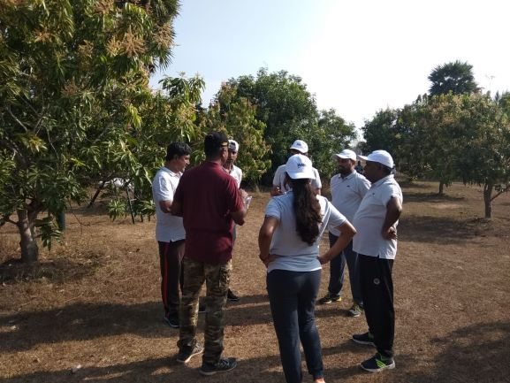

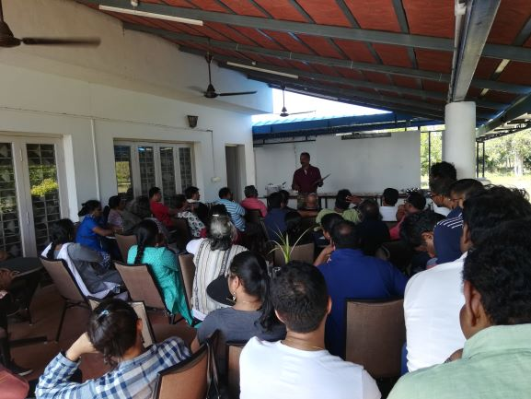

GROW and GLOW
Make a ‘Cutting Edge’, Break the Barrier
and
‘ADVANCE’ despite ‘ADVERSITY’
Knowing ‘Which Direction to Move on’ is Not Just Enough;
Equally Essential is to Know ‘How to Find Directions’
Knowing ‘What’ as well as ‘How’
You may have a Map & a Compass;
But, do you know How to Use Them?
Having ‘Tools’ as well as ‘Skills’

Slide 15
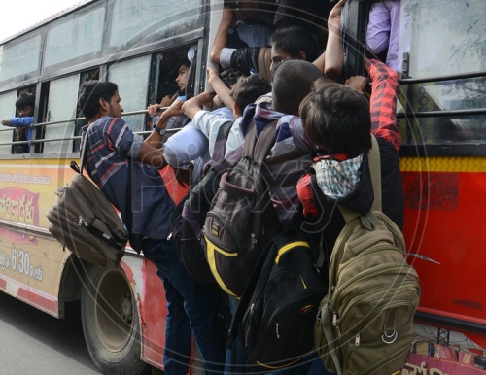
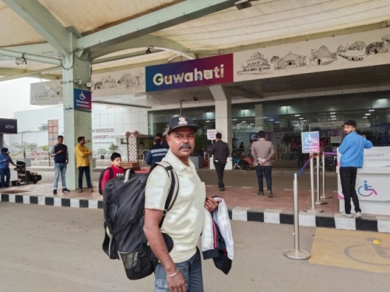
Vibrant Outdoorsmanship Making of a Vibrant Human Being
Captain Subbu’s
– Are You –
A Forced Traveller with Low Energy?
or
An Avid Traveller with Less Engagement?
– Transform –
A Monotonous Traveller
into
A Vibrant Explorer!
Acquiring an Art is a Skill & Acquiring a Skill is an Art!
Be a ‘Skillful Artist’ and sketch the course of your own life!
Outdoorsmanship Moulds your Mind Fertile, Tunes your Brain Active & Keeps your Body Fit!

Slide 16
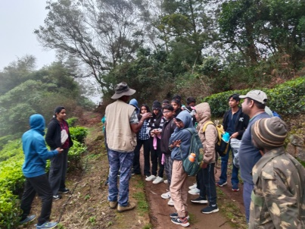
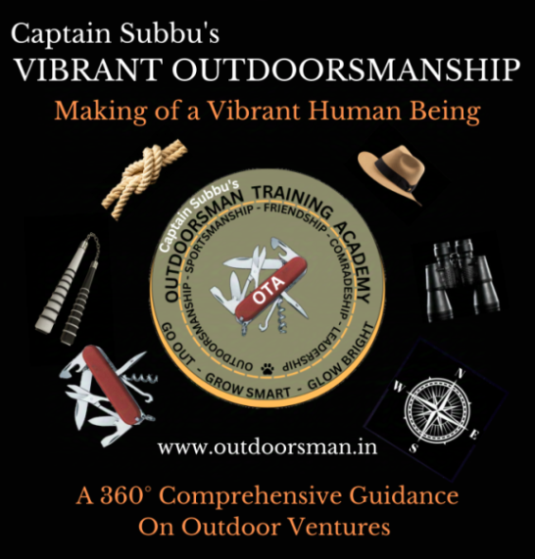
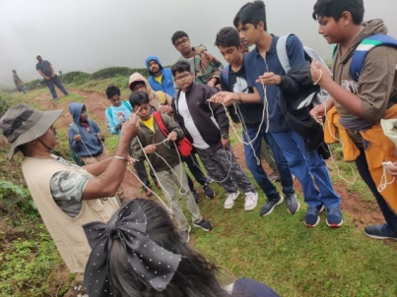
Vibrant Outdoorsmanship Workshop
Making of a Vibrant Human Being
Workshop Takeaways: Learn to
1. Sail through ‘Outdoorsmanship – Sportsmanship – Friendship – Comradeship – Leadership’ Circle
2. Make all your Outdooor Ventures a Purposeful, Meaningful, Responsible & an Enjoyable ones
3. Energize all your Travels with Everlasting Invigoration
4. Generate a Positive Vibe permanently around you
5. Know the Nuances of the Outdoor Skills & Enable you to Engage, Entertain & Educate others while venturing outdoors
6. Acquaint with Outdoor Mindset, Skillset & Outset to become an Energetic & Engaging Outdoorsman
7. Transform your ‘Just Outings’ into ‘Justified Outings’
8. Make a ‘Fulfilling Life’ imbibing ‘Love Living & Live while Living’ philosophy

Slide 17
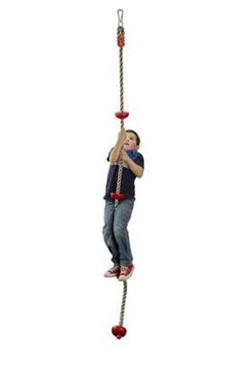
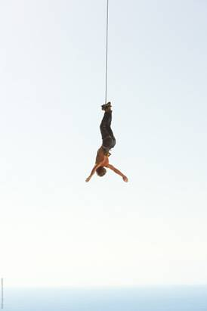
Captain Subbu’s
ACOMPLISH your AMBITIONS Coaching
Making of a Warrior Entrepreneur Leader
– Are You –
A Victor of Achievements?
or
A Victim of Circumstances?
– Transform –
Liberate Yourself from being a
Prisoner of Circumstances
Conquer Your World with Confidence!
Envision your Vision with an Entrepreneur’s Smartness
and
Execute your Mission with a Warrior’s Shrewdness

Slide 18

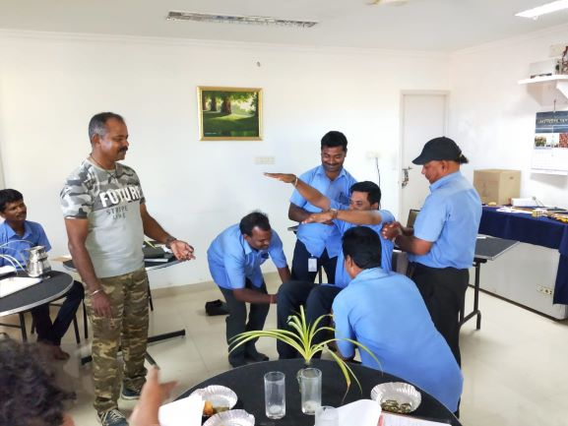
ACOMPLISH your AMBITIONS Coaching
Making of a Warrior Entrepreneur Leader
Coaching Takeaways: Learn to
1. Liberate yourself from being a Prisoner of Circumstances & Conquer your World with Confidence
2. Come out of ‘Comfort Zone’ with Ease, Comfort & Confidence
3. Bridge the Gap between ‘Expectation & Realization’ and
Accomplish your Ambitions, both Personal & Professional
4. Many Opportunities / Losses are invisible and go unnoticed
due to ‘Lack of Awareness & Preparedness’. Avoid this through
better ‘Visibility & Accountability and by ‘Effective Mobilization of Available Resources’
5. Acquaint with 65 Essential Powers to generate Positive Energy & Attitude and 12 Endangering Syndromes to get rid of Negative Energy & Attitude
AMBITIONS
Don’t Crave; Just Carve!
The ‘Nature’ of an individual can be ‘Nurtured’ through ‘Personality Engineering’
Only One Life – Love it & Live it

Slide 19
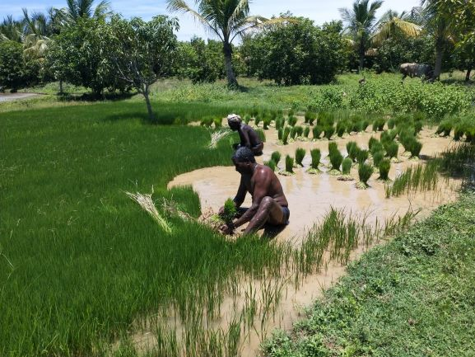
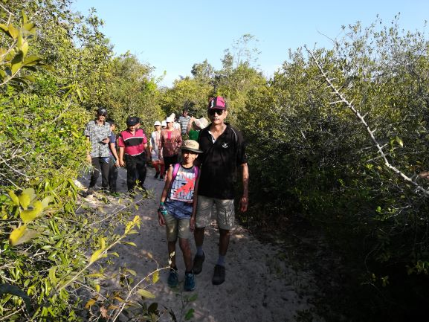
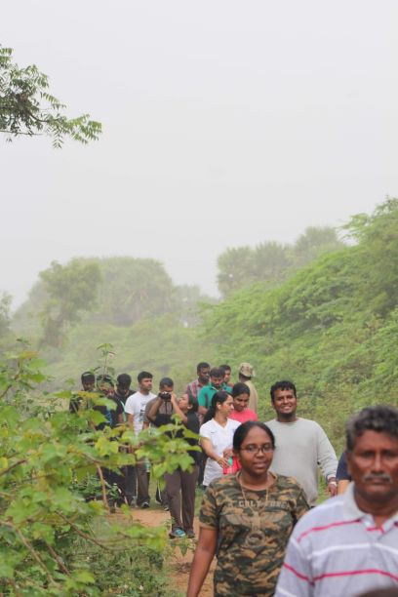
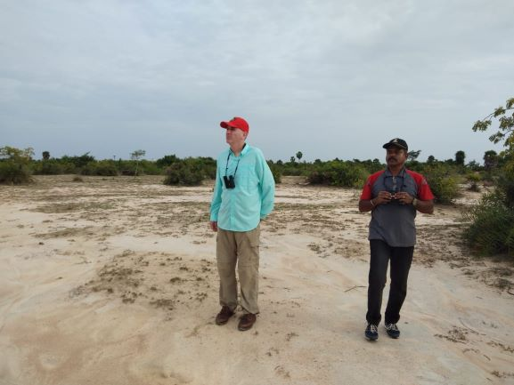
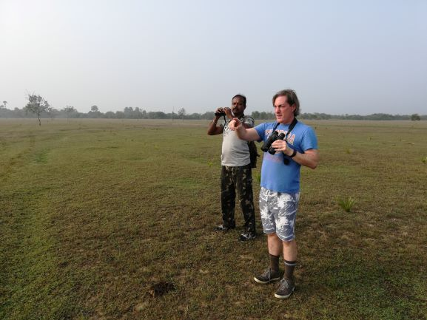
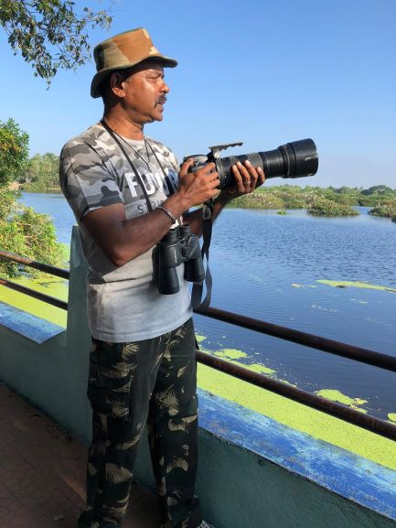
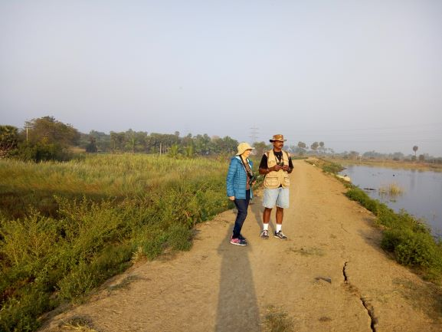
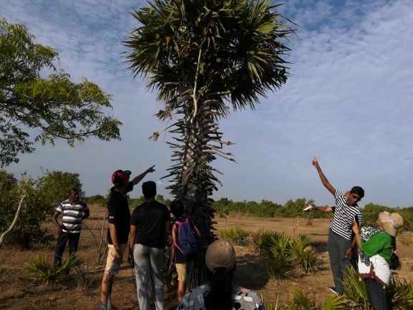
Road Less Travelled
Nature Walks
Easy Trek
Moderate Trek
Tough Trek
Village Life & Farming
Bird Watching
1. Individual / Group Birding Trip
2. Bird Sanctuary Visit
3. Bird Photography
4. Bird & Birding Workshop

Slide 20
Whom We Do? – The Participants

Slide 21
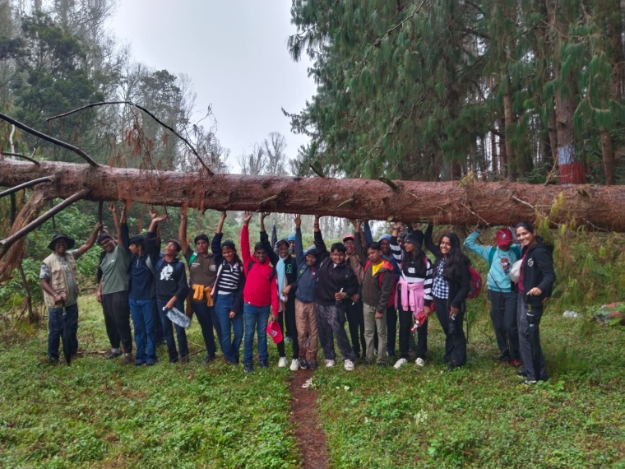
The Participants
1. Corporate Teams
2. Student Groups (Schools / Colleges)
3. Social Clubs
4. Hobby Clubs
5. Fitness / Sports Communities
6. Family & Friends Groups
7. Individuals

Slide 22
Why We Do? – The Takeaways

Slide 23
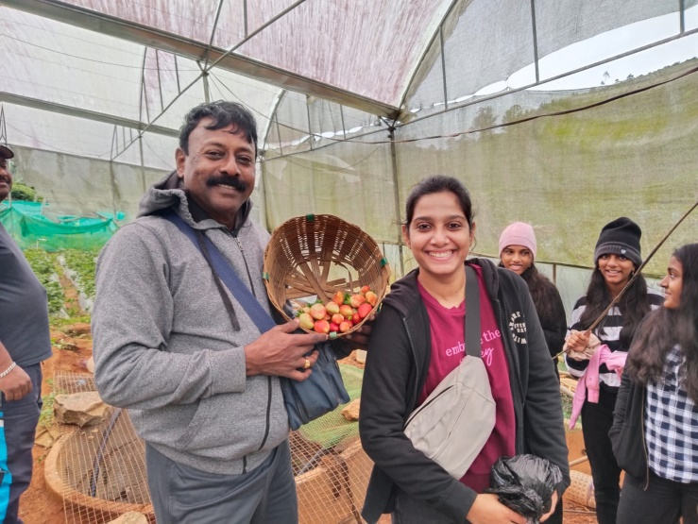
The Takeaways
Learn to
1. Expand the Known & Explore the Unknown
2. Sail through ‘Outdoorsmanship – Sportsmanship – Friendship – Comradeship – Leadership’ Circle
3. Liberate yourself from being a Prisoner of Circumstances & Conquer your World with Confidence
4. Incorporate ‘Adventure’ into the mind with calculated risks by applying the ‘I Can – I Will – I Do’ philosophy
5. Know the ‘You’ in ‘You’ and enhance yourself by acquiring new skills to Grow and Glow in life
6. Merge with the team and emerge as a leader by effectively fielding the ‘Team Bonding’ applying the ‘Teamwork Works’ philosophy
7. Make a ‘Fulfilling Life’ imbibing ‘Love Living & Live while Living’ philosophy

Slide 24
Where We Do? – The Campsites, Barracks & Nests

Slide 25
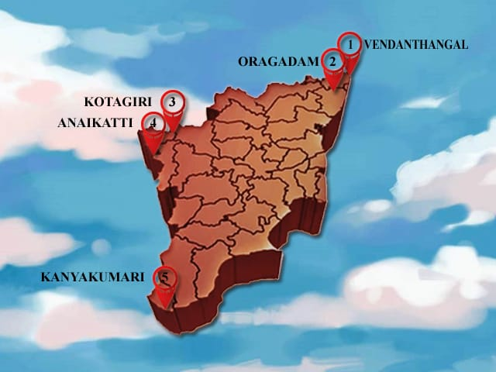

Where We Do?
1. In Our Campsite / Barrack
2. On Your Campus
3. At a Common Location
Camp Catapult Locations
1. Vedanthangal (Near Chennai)
2. Oragadam (In Chennai)
3. Kotagiri (Near Ooty)
4. Anaikatti (Near Coimbatore)
5. Marudhanallur (Near Kumbakonam)
6. Kanyakumari – Soon to Bloom
Captain’s Barrack Locations
1. Thazhakudy (Near Kanyakumari)
2. Soon to Bloom

Slide 26



Campsite Accommodation, Facilities & Amenities
1. Accommodation in Tents @ Vedanthangal & Anaikatti, in Cottages @ Kotagiri & in Rooms @ Oragadam
2. Clean & Hygienic Bathrooms & Toilets
3. Kitchen & Dining Facilities
4. Activity Fields
5. Brain-Storming Area with Basic Conferencing Amenities
6. Expansive Nature to Explore & Extended Hands to Lead

Slide 27
Who Facilitates? – The Team

Slide 28





The Team
Capt Subbu
The Founder & the Chief Mentor
Jagobandhu Barman
Facilitator
OBT Activities
Skylab Kumar
Facilitator
Nature Activities
Lokesh
Facilitator
Outdoor Cooking
Vignesh
Camp Architect

Slide 29

Capt KR Subramoniam (Capt Subbu)
Outdoorsmanship Mentor
Author | Adventurer | Birder | Camper | Out Bound Trainer
1. Founder Operator of Outdoorsman Training Academy, Camp Catapult & Captain’s Barrack that carry out Outdoorsmanship Programs, Adventure Activities, Nature Camping & Out Bound Trainings with Campsites @ Vedanthangal, Oragadam, Kotagiri & Anaikatti and Barracks @ Thazhakudy & Thanthanadu
2. Carries out ‘VIBRANT OUTDOORSMANSHIP – Making of a Vibrant Human Being’ Workshop to Invigorate your Outdoor Ambitions through 360° Integrated & Comprehensive Guidance on Outdoor Ventures with Practical Explanations for Personal Applications
3. Carries out ‘ACCOMPLISH your AMBITIONS – Making of a Warrior Entrepreneur Leader’ Coaching to transform you to Envision the Vision with an Entrepreneur’s Smartness & Execute the Mission with a Warrior’s Shrewdness to Conquer your World with Confidence
4. Author of Books: 1. Romancing de Life: Live Smart–Live a Royal Life, 2. Warrior Entrepreneur–Growing and Glowing, 3. Karma to Dharma–Ultimate before Ultimatum, 4. Vibrant Outdoorsmanship–Making of a Vibrant Human Being & 5. Aspire to Inspire (Co-Author)
5. Recipient of a Special Service Medal from the Indian Army & an Appreciation Medal from the US Navy
6. Mastermind Leader in TLC (Community for Teachers, Authors, Speakers & Coaches)
7. Certified Rock Climbing Trainer & Climbed up to 21,000 feet on the Mighty Himalayas
8. Martial Arts Trainer | Yoga Practitioner | Practices 25+ Hobbies | Reads 20-30 Pages Every Day
9. Over 30 years, acquired a Wide & Wild Practical Experience in various Fields & Industries like Indian Army | Hotel Industry | Oil & Natural Gas Industry | Travel & Conference Management | Successfully Launched a School | Successfully Re-established an uprooted Telecom Business back into Operation | Senior Citizen Active Living Management | Facilities Management | Successfully Conceptualized & Established Adventure & Nature Campsites
10. My Own Favourite Quotes: 1. Expand the Known & Explore the Unknown to GROW and GLOW in Life! & 2. I Can, I Will & I Do
Capt Subbu
I Can – I Will – I Do
98415 75740

Slide 30

A Proud Moment
The Law of ‘Attraction’ through ‘Aspiration’ with ‘Action’ with ‘Attraction’
Army Chief General Dalbir Singh, PVSM, UYSM, AVSM, VSM, ADC receiving 'Romancing de Life: Live Smart–Live a Royal Life' book authored by Captain KR Subramoniam in a Glorious Ceremony!

Slide 31





Capt Subbu – The Author
Book-1: Romancing de Life: Live Smart–Live a Royal Life
Book-2: Warrior Entrepreneur–Growing and Glowing
Book-3: Karma to Dharma–Ultimate before Ultimatum
Book-4: Vibrant Outdoorsmanship–Making of a Vibrant Human Being
Book-5: Aspire to Inspire (Co-Author)
Book-6: Writing in Progress

Slide 32

Plunge Yourself Into
GROW and GLOW
Programmes
Think Big & Ask More

Slide 33





I hear, I forget!
I see, I remember!!
I do, I understand!!!

Slide 34

“If I do, I understand…”
“If I don’t do, I don’t understand…”
?
“If I don’t understand, I can’t do…”
“If I understand, I can do better…”

Slide 35


When the going gets tough, only the tough gets going
Fortune Favours Prepared Minds
Give a man a fish, you feed him for a day;
Teach a man to fish, you feed him for lifetime!

Slide 36

Tough Times Never Last, but Tough People Do
Together Everyone Achieves More

Slide 37


Our Valuable Well-Wishers
Slash Support, Chennai
National Institute of Technology (NIT), Trichy
Lotte India (Parry Group), Chennai
Accenture, Chennai
ABI Constructions, Chennai
Solution Bridge Management Services, Trichy
Sishya School, Chennai
Ernst & Young, Chennai
Infosys, Chennai
American Megatrends India Pvt Ltd (AMI)
Plumes School of Self Enhancement, Salem
KPMG, Chennai
Hella Automotive, Chennai
Confederation of Indian Industries (CII – Young Indian Entrepreneurs)

Slide 38


Our Valuable Well-Wishers
Amrutanjan, Chennai
XM Software Solutions, Chennai
Fulcrum Tours & Travels (P) Ltd
Harsha Hospitality Solutions
SIP Academy
Velammal School, Mogappair, Chennai
Port Singapore Authority (PSA)
Velammal School, Medavakkam, Chennai
Pace Global HR
Viasat, Chennai
Estancia IT Park (Zoho Corp), Chennai
National Institute of Fashion Technology (NIFT), Chennai
Valeo India
Empower

Slide 39



Our Valuable Well-Wishers
Phoenix Marketcity
Axeon Marketing India
Exoticamp
Bala Vidya Mandir School, Adyar, Chennai
IVAR Business Development Company
Budding Minds International School, Chennai
Kendriya Vidyalaya, IIT, Chennai
Excel Group of Schools
ADP India Pvt Ltd
Wittur Elevator Components India Pvt Ltd
Forbes Technologies India
Amazon, Chennai
Many assorted Corporate Teams, Student Groups, Families as well as Individuals

Slide 40

Catapult Project Handholding Services
1. MANER & ACTORS Concepts
2. Obstacle Challenging & Overcoming (OCO) Course set up
3. Mind, Brain & Body Coordination (MBBC) Course set up
4. Team set up (Train the Trainers / Staff)
5. Special Training
1. Out Bound Training (OBT) & Team Bonding Activities
2. Beginner’s Workshops
3. Vibrant Outdoorsmanship Workshop
4. Accomplish your Ambitions Coaching
6. Periodical Visits to Audit / Update / Upgrade
7. Coordinated Visits for Special Events
8. Indirect Passive Marketing
9. In-house Training for Company Staff

Slide 41


Expand the Known & Explore the Unknown
to GROW and GLOW
This World is for the
Survival of the Fittest…
And You be the Finest…
Thanks!
Mobile: +91 - 98415 75740
E-Mail: outdoorsmantraining@gmail.com
Website: www.outdoorsman.in
Sail through ‘Outdoorsmanship – Sportsmanship – Friendship – Comradeship – Leadership’ Circle

